Slide 1
Object Oriented Programming (OOP)
Week – 03
Dated: 23/10/2024
Instructor: AHMED AWAIS

Slide 2
Method Overloading
Multiple methods in the same class can have the same name but different parameters (different number, types, or order of parameters).
class Calculator {
int add(int a, int b) {
return a + b;
}
double add(double a, double b) {
return a + b;
}
}
It is a form of compile-time polymorphism, where the correct method to call is determined at compile time based on the method signature.

Slide 3
Method Overriding
A subclass can provide a specific implementation of a method that is already defined in its superclass.
It is a form of runtime polymorphism, where the correct method to call is determined at runtime based on the object's type.
class Animal {
void sound() {
System.out.println("Animal makes a sound");
}
}
class Dog extends Animal {
@Override
void sound() {
System.out.println("Dog barks");
}
}

Slide 4
Constructor
A constructor is a member function of a class which initializes objects of a class.
Constructor is automatically called when object(instance of class) create

Slide 5
How constructors are different from a normal member function?
Constructor has same name as the class itself.
Constructors don’t have return type.
A constructor is automatically called when an object is created.
If we do not specify a constructor, compiler generates a default constructor for us (expects no parameters and has an empty body).

Slide 6
Types of Constructors
Default Constructor: Default constructor is the constructor which doesn’t take any argument. It has no parameters.
Parameterized Constructors: It is possible to pass arguments to constructors. Typically, these arguments help initialize an object when it is created.
Copy Constructor: A copy constructor is a member function which initializes an object using another object of the same class.

Slide 7
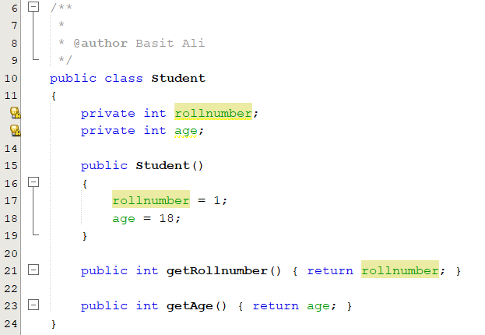
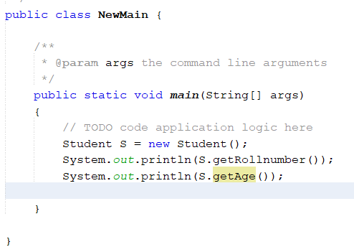
1. Default Constructor

Slide 8
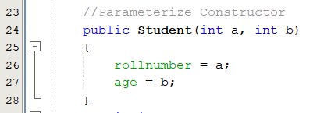

2. Parameterized Constructors
When an object is declared in a parameterized constructor, the initial values have to be passed as arguments to the constructor function. The normal way of object declaration may not work. The constructors can be called explicitly or implicitly.

Slide 9
2. Parameterized Constructors
Uses of Parameterized constructor:
It is used to initialize the various data elements of different objects with different values when they are created.
It is used to overload constructors.
Can we have more than one constructors in a class? Yes, It is called Constructor Overloading.

Slide 10
Constructor Overloading
Just like other member functions, constructors can also be overloaded. Infect when you have both default and parameterized constructors defined in your class you are having Overloaded Constructors, one with no parameter and other with parameter.
You can have any number of Constructors in a class that differ in parameter list.

Slide 11
Constructor Overloading
Multiple constructors in the same class can have the same name but different parameter lists.
It is often used to provide different ways to initialize an object based on what data is available at the time of creation.

Slide 12
class Person {
String name;
int age;
// Overloaded constructors
Person(String name) {
this.name = name;
}
Person(String name, int age) {
this.name = name;
this.age = age;
}
}

Slide 13
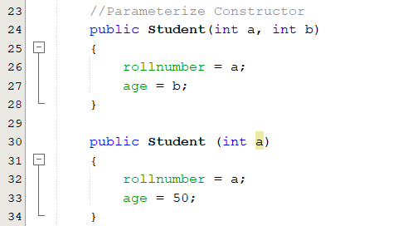
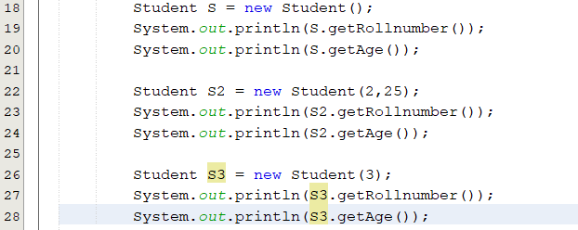
Constructor Overloading

Slide 14
Is constructor or class members private by default?
By default, a constructor (or any class member) in Java is not private.
Key points regarding access modifiers for constructors in Java:
Access Modifiers Overview Public: A public constructor allows the class to be instantiated from any other class, regardless of the package.
Protected: A protected constructor allows the class to be instantiated only within its own package and by subclasses, even if those subclasses are in different packages.
Default (Package-Private):If no access modifier is specified, the constructor has default or package-private access. This means it can only be accessed by classes in the same package. This is not the same as being private.
Private:A private constructor restricts instantiation to within the class itself. This is often used in singleton patterns or static utility classes where you do not want instances to be created from outside the class.
By default, if no access modifier is specified, a constructor is package-private, meaning it is accessible only within classes in the same package. It is not private unless explicitly declared as such.

Slide 15
class Vehicle {
// This constructor has package-private access
Vehicle() {
System.out.println("I am Vehicle's Constructor");
}
}
class Car extends Vehicle {
public Car() {
System.out.println("I am Car's Constructor");
}
}
public class Main {
public static void main(String[] args) {
// Vehicle vehicle = new Vehicle(); // This would be fine only if Main is in the same package as Vehicle
Car car = new Car(); // This works because Car can call the Vehicle constructor
}
}
In this example, if Vehicle is defined in a different package from Main, you cannot instantiate Vehicle directly in Main, but you can still instantiate Car because it extends Vehicle.

Slide 16
Last type - copy constructor
We will see it later …

Slide 17
3. Copy Constructor
A copy constructor is a member function which initializes an object using another object of the same class.
A copy constructor has the following general function prototype:
ClassName (ClassName old_obj);

Slide 18
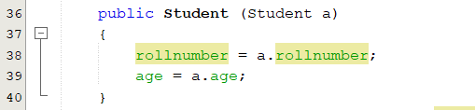

3. Copy Constructor

Slide 19
When is user-defined copy constructor needed?
Shallow and deep copy concepts naturally lead to discussing user-defined copy constructors because handling memory correctly is essential when dealing with objects that involve dynamic memory allocation (like pointers or references to objects).
A user-defined copy constructor allows fine-grained control over how objects are copied, especially in scenarios where the default shallow copy behavior can lead to problems like double deletion or unintended sharing of resources.
If we don’t define our own copy constructor, the C++ compiler creates a default copy constructor for each class which does a member-wise copy between objects
The compiler created copy constructor works fine in general. We need to define our own copy constructor only if an object has pointers or any runtime allocation of the resource like file handle, a network connection..etc.

Slide 20
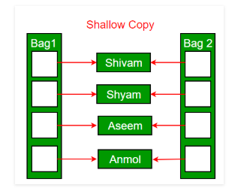
Shallow Copy Vs Deep Copy
Default constructor does only shallow copy.

Slide 21
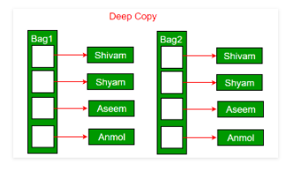
Shallow Copy Vs Deep Copy
Deep copy is possible only with user defined copy constructor. In user defined copy constructor, we make sure that pointers (or references) of copied object point to new memory locations.

Slide 22
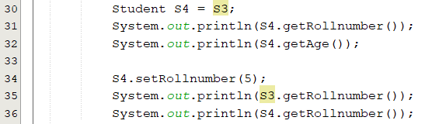
Shallow Copy

Slide 23
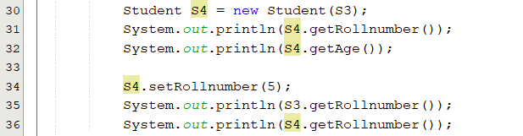
Deep Copy

Slide 24
Exercise
Create a class called Employee that includes three pieces of information as instance variables
a first name (type String)
a last name (type String)
a monthly salary (double)
If the monthly salary is not positive, set it to 0.0.
Write a test application named EmployeeTest that demonstrates class Employee’s capabilities. Create two Employee objects and display each object’s yearly salary. Then give each Employee a 10% raise and display each Employee’s yearly salary again. Use appropriate methods for this program wherever needed.

Slide 25
Exercise
Create a 'DISTANCE' class with : - feet and inches as data members – member function to input distance
- member function to output distance
- member function to add two distance objects
Write a main function to create objects of DISTANCE class. Input two distances, add them in new distance instance and display the result.

